Slide 1
Rule-Based Collaborative Filtering, Association Rules, Naive Bayes Collaborative Filtering, Neural Network, Singular Value Decomposition, Stochastic Gradient Descent, Regularization.

Slide 2
Rule-Based Collaborative Filtering Using Association Rules
Relationship Between Association Rules and Collaborative Filtering
Association rule mining was originally used to discover relationships in supermarket transaction data.
It is naturally defined over binary data but can be extended to categorical and numerical data by conversion.
In supermarket transactions and implicit feedback datasets, unary data is common, where 1s indicate a purchase and 0s indicate missing values (often approximated as "not purchased").

Slide 3
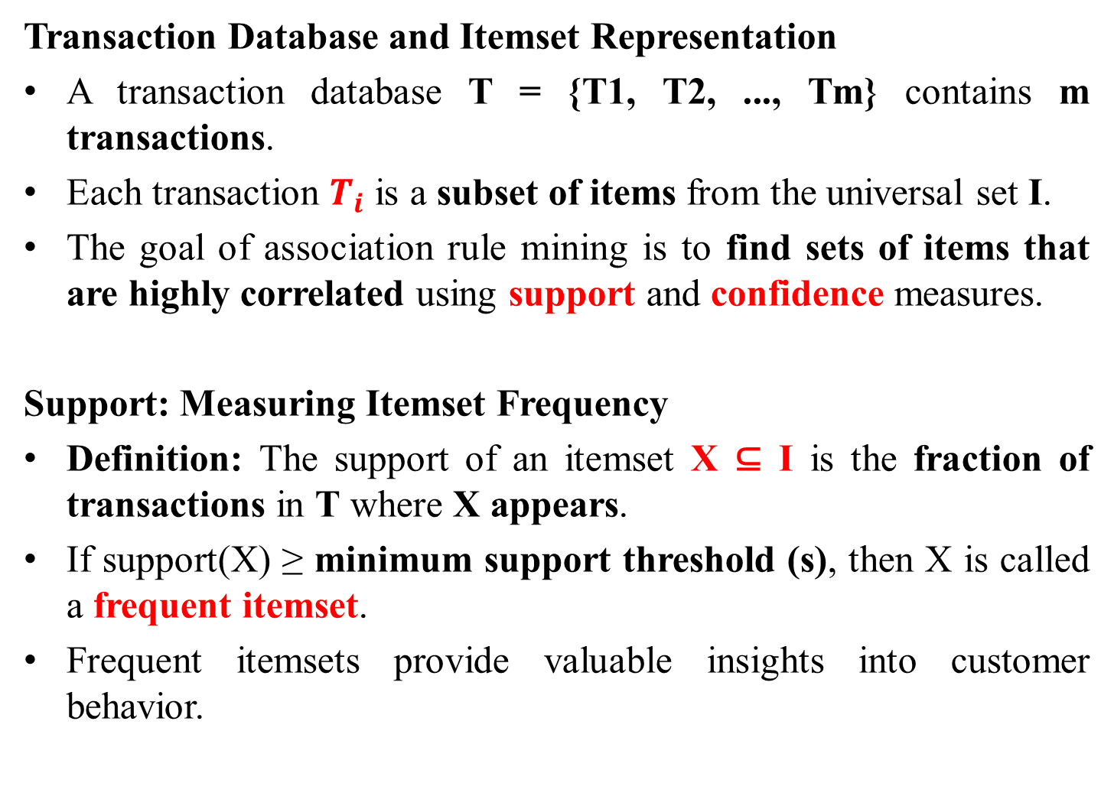
Transaction Database and Itemset Representation
A transaction database T = {T1, T2, ..., Tm} contains m transactions.
Each transaction $T_{i}$ is a subset of items from the universal set I.
The goal of association rule mining is to find sets of items that are highly correlated using support and confidence measures.
Support: Measuring Itemset Frequency
Definition: The support of an itemset X ⊆ I is the fraction of transactions in T where X appears.
If support(X) ≥ minimum support threshold (s), then X is called a frequent itemset.
Frequent itemsets provide valuable insights into customer behavior.

Slide 4
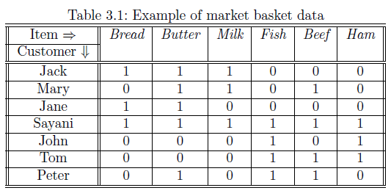
Example of Support in Market Basket Data (Table 3.1)
Two frequent itemsets identified:
{Bread, Butter, Milk}
{Fish, Beef, Ham}
These itemsets have a support of at least 0.2, meaning they appear in at least 20% of transactions.
Implication for Recommendation Systems:
If a customer buys {Butter, Milk}, they are likely to buy Bread (like Mary in the table).
If a customer buys {Fish, Ham}, they are likely to buy Beef (like John in the table).

Slide 5
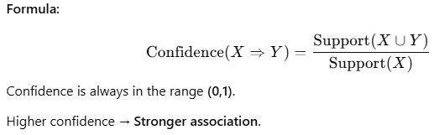
Association Rules and Confidence
Definition: An association rule is an implication of the form
X ⇒ Y, where:
X (antecedent): Items already purchased.
Y (consequent): Items that can be recommended.
Example Rule: {Butter, Milk} ⇒ {Bread}
Useful for recommending Bread to Mary, since she has already bought Butter and Milk.
Confidence Measure: The strength of the rule is measured by confidence:

Slide 6
Finding Association Rules: Two-Phase Algorithm
Frequent Itemset Mining:
Find all frequent itemsets satisfying minimum support (s).
Computationally intensive phase (especially for large databases).
Many optimized algorithms exist to speed up this process.
Rule Generation:
Partition each frequent itemset into X (antecedent) and Y (consequent).
Generate rules X ⇒ Y.
Retain rules that satisfy minimum confidence (c).

Slide 7
Importance of Association Rule Mining in Collaborative Filtering
Helps in discovering hidden correlations between products in transactional data.
Useful for:
Personalized recommendations (e.g., suggesting items frequently bought together).
Targeted marketing strategies (e.g., offering discounts on complementary items).
Comparison with Collaborative Filtering:
Unlike traditional collaborative filtering, association rules do not require user ratings.
More effective in cases where implicit feedback (purchase history) is available.

Slide 8
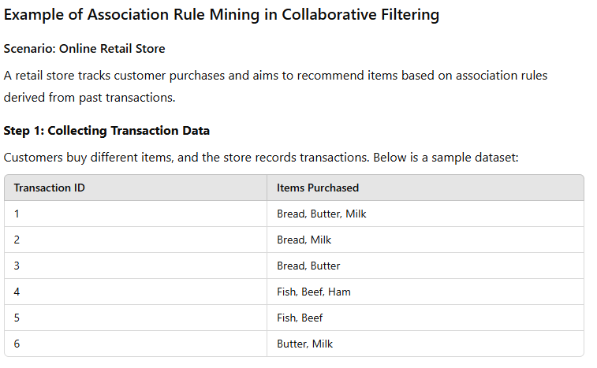

Slide 9
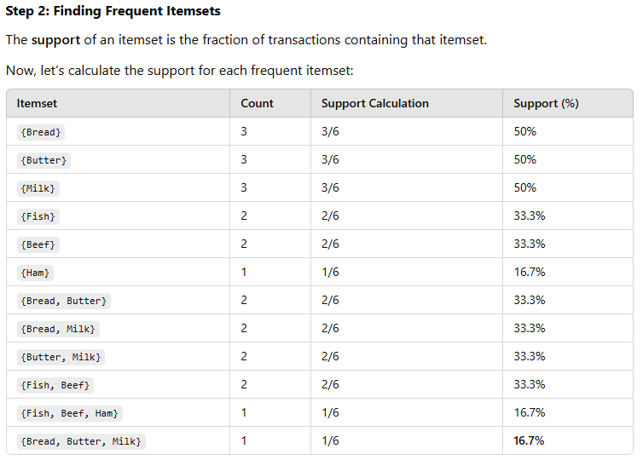

Slide 10
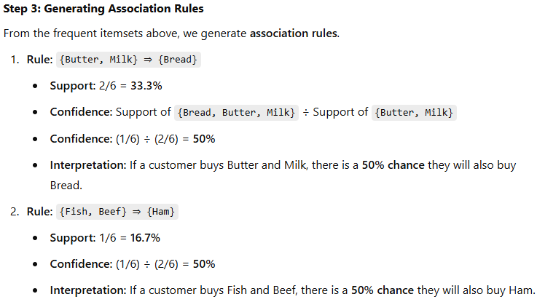
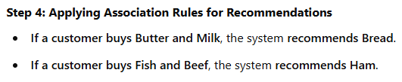

Slide 11
Leveraging Association Rules for Collaborative Filtering
Association Rules and Unary Ratings Matrices
Unary ratings matrices arise from customer activities (e.g., purchases) where a customer only indicates a "like" (not a dislike).
Unary Data Representation:
Items purchased (liked) → 1
Missing items (not purchased) → 0
Unlike typical rating matrices, missing values in unary matrices are approximated as 0 to simplify processing.
Unary matrices are sparse, meaning most values are 0, making it acceptable to assume missing values are "not purchased."
The matrix is treated as binary data, allowing association rules to be applied.

Slide 12
Discovering Association Rules
Association rules are found by analyzing patterns of item co-occurrence in transactions.
Steps to Generate Association Rules:
Find frequent itemsets using a minimum support threshold (s).
Generate association rules (X ⇒ Y) using a minimum confidence threshold (c).
Retain only rules where the consequent contains exactly one item.
This set of rules is used for recommendation modeling.

Slide 13
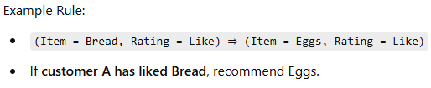
Recommending Items to a Customer
Consider a customer A, and we want to recommend relevant items.
Steps:
Identify all rules "fired" for customer A, meaning the antecedents of the rule match items A has purchased.
Sort fired rules by decreasing confidence.
Top-k items in the consequents of these rules are recommended to the customer.

Slide 14
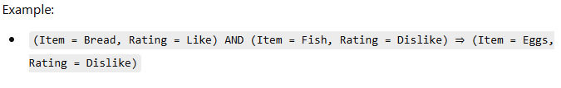
Handling Numeric Ratings in Association Rules
Unary matrices only capture "likes," but real-world ratings involve numeric values (e.g., 1-5 stars).
Approach for Numeric Ratings:
Convert each (item, rating) pair into a pseudo-item.
Example: (Item = Bread, Rating = Dislike) is treated as a distinct item.
Construct rules using pseudo-items rather than simple item names.

Slide 15
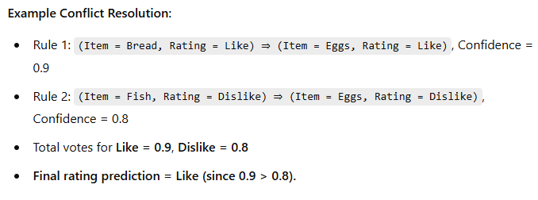
Resolving Conflicts in Rule-Based Predictions
Since rules can contradict each other (e.g., one rule predicts Like, another predicts Dislike), conflicts must be resolved.
Approach to Conflict Resolution:
Use weighted voting based on confidence values.

Slide 16
Weighted Voting for Prediction
Instead of strict rules, ratings can be numerically aggregated.
Steps:
Identify all fired rules predicting ratings for a given item.
Sum up votes for each rating based on the rule’s confidence.
The highest weighted rating determines the predicted rating.
The sorted list of top-rated items is recommended to the user.
Using Interval-Based Ratings
When the rating scale has many possible values (e.g., 1-5 stars):
Convert the scale into a smaller set of intervals (e.g., 1-2 = "Low", 3 = "Medium", 4-5 = "High").
Apply Association rule mining on the interval-based ratings.
This allows handling continuous ratings in a structured way

Slide 17
Item-Specific Support for Better Recommendations
Instead of one global support threshold, different items can have different support values.
Example:
A rarely purchased item may still be important, so a lower support threshold should be used.
A frequently purchased item should have a higher support threshold.
Using item-specific support can improve the quality of recommendations.

Slide 18
Benefits of Rule-Based Collaborative Filtering
Does not require explicit user ratings, making it useful for implicit feedback systems (e.g., e-commerce).
Scalable for large transaction datasets with efficient frequent pattern mining algorithms.
Handles sparse data well by using association rules to infer recommendations.
Supports both binary and numeric ratings, allowing flexible recommendation models.

Slide 19
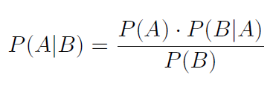
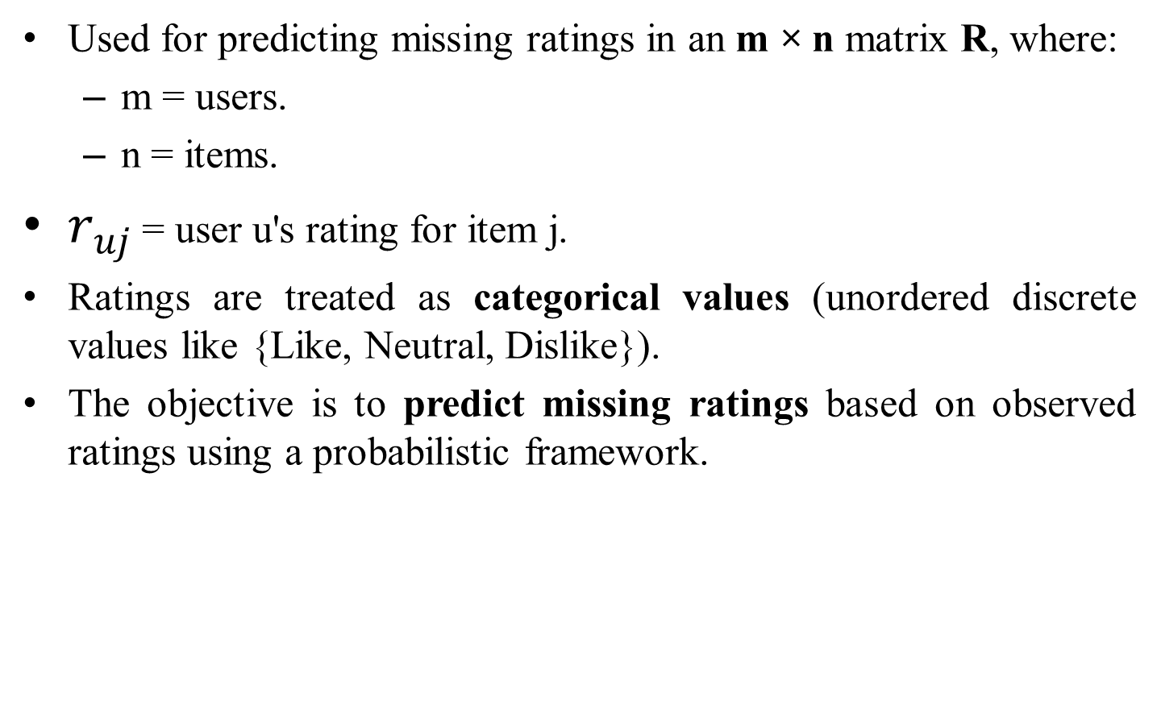
Naïve Bayes Model in Collaborative Filtering
Used for predicting missing ratings in an m × n matrix R, where:
m = users.
n = items.
$r_{uj}$ = user u's rating for item j.
Ratings are treated as categorical values (unordered discrete values like {Like, Neutral, Dislike}).
The objective is to predict missing ratings based on observed ratings using a probabilistic framework.

Slide 20
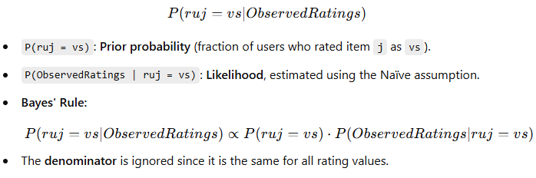
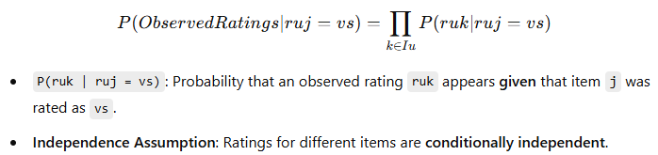
Application of Bayes' Theorem
We compute the probability of a missing rating based on observed ratings:
Estimating Conditional Probabilities
The Naïve Bayes assumption is applied: Ratings are independent given a specific rating for item j.

Slide 21
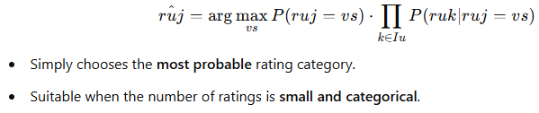
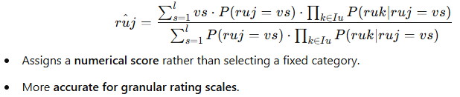
Methods to Estimate the Missing Rating
Two main methods are used to predict the rating:
Method 1: Maximum Probability Estimate
Select the rating value with the highest probability.
Method 2: Weighted Average Prediction
Computes a probability-weighted average of all possible ratings.

Slide 22
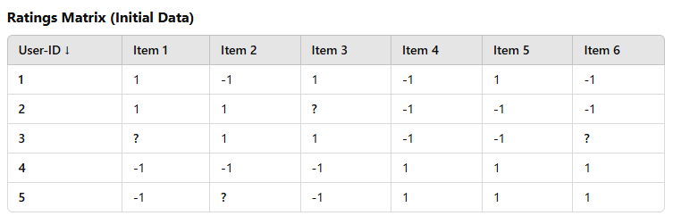
Example
Predicting Movie Ratings Using Naïve Bayes
We have a binary ratings matrix where users rate movies with either 1 (Like) or -1 (Dislike). Our goal is to predict the missing ratings using Bayes' Theorem.
Given Data:
We need to predict User 3’s rating for Movie 1.

Slide 23
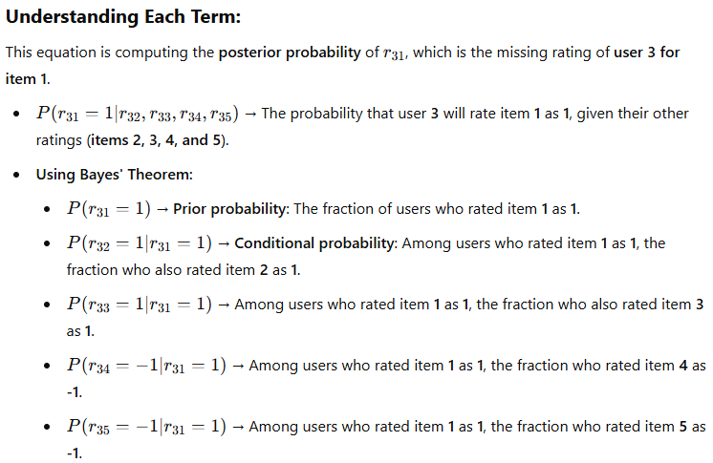
Step 1: Apply Bayes’ Theorem
Using Bayes' Rule, we compute:

Slide 24
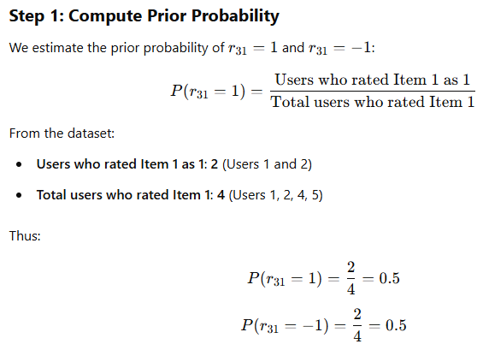
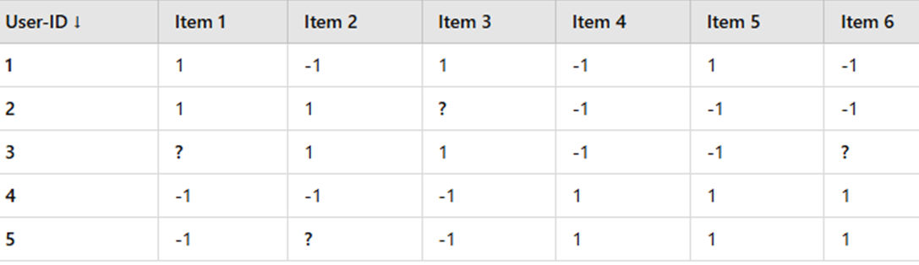

Slide 26
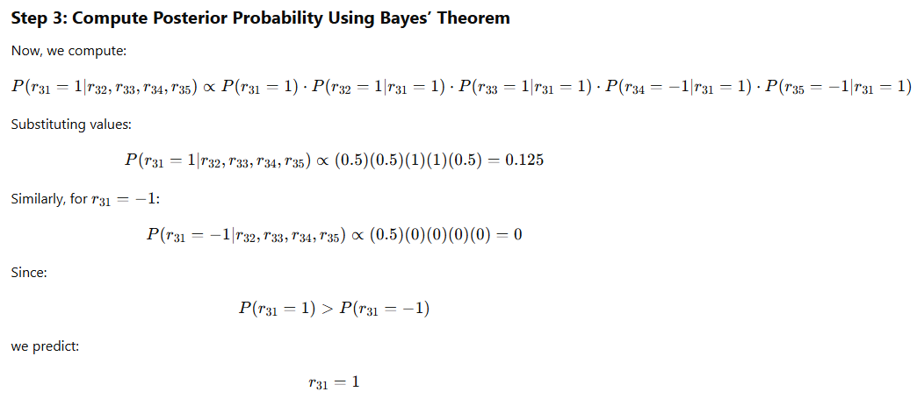
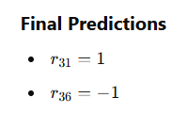
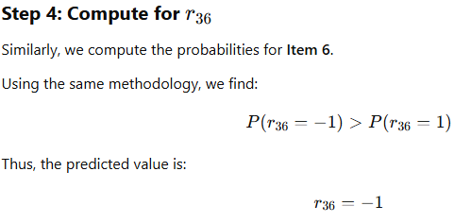

Slide 27
Item-Based vs. User-Based Naïve Bayes
Item-Based Naïve Bayes: Predicts a user's rating for an item based on the user's other ratings.
User-Based Naïve Bayes: Predicts a user's rating for an item based on how other users rated the same item.
Hybrid Approach: Combines both item-based and user-based probabilities for a better prediction.
Example Scenario
Use Case: Movie Recommendation
Problem: A streaming service wants to predict whether a user will Like, Neutral, or Dislike a movie based on their past ratings.
Approach:
Construct a ratings matrix where users rate different movies.
Apply Naïve Bayes to estimate missing ratings using observed ones.
Use Maximum Probability Estimate or Weighted Average Prediction to predict the most likely rating.
Recommend movies with the highest predicted ratings.

Slide 28
Using Neural Networks as a Black-Box in Collaborative Filtering
Arbitrary Classification Model in Collaborative Filtering
Many classification/regression methods can be extended to collaborative filtering.
The main challenge is handling incomplete data due to missing values.
Unary data (where missing values are assumed to be 0) can be used in sparse high-dimensional scenarios.
Methods like support vector machines (SVMs) and regression models can be adapted.

Slide 29
Handling Missing Values
Missing values in non-unary data cannot be replaced with 0 without bias.
Dimensionality reduction techniques can be used to transform data into a fully specified low-dimensional representation.
Classification methods can work as meta-algorithms with iterative refinement.
Iterative Refinement for Prediction
Missing values are initially filled using:
Row or column averages
Simple collaborative filtering algorithms (e.g., user-based methods)
Bias removal (mean-centering each row) helps improve accuracy.

Slide 30
The algorithm iteratively refines missing values:
Step 1: Use a classification/regression model to estimate missing values.
Step 2: Update missing entries with predicted values and repeat.
Neural Networks as a Black-Box Model
Neural networks simulate the human brain using neurons and weights.
Perceptron Model (Basic single-layer neural network)
Uses weights and an activation function to classify inputs.
Multilayer Neural Networks (Deep learning models)
Can compute complex, nonlinear functions for better predictions.

Slide 31
Using Neural Networks for Collaborative Filtering
Each item is predicted using the ratings of other items as input.
Mean-centering is applied to normalize ratings before training.
The neural network model is iteratively updated using:
Training the model with available data.
Updating missing ratings using predictions.
Repeating until convergence.

Slide 32
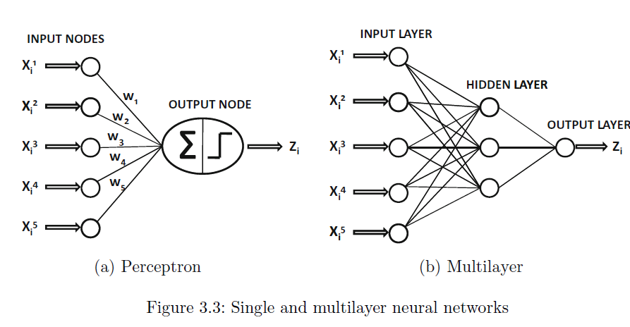
Example: Neural Network-Based Collaborative Filtering
Step 1: Understanding the Input Data
We have a user-item rating matrix (Figure 3.4).
Users (U1 to U6) have rated movies (Gladiator, Ben-Hur, Godfather, Goodfellas).
Some ratings are missing and need to be predicted.

Slide 33
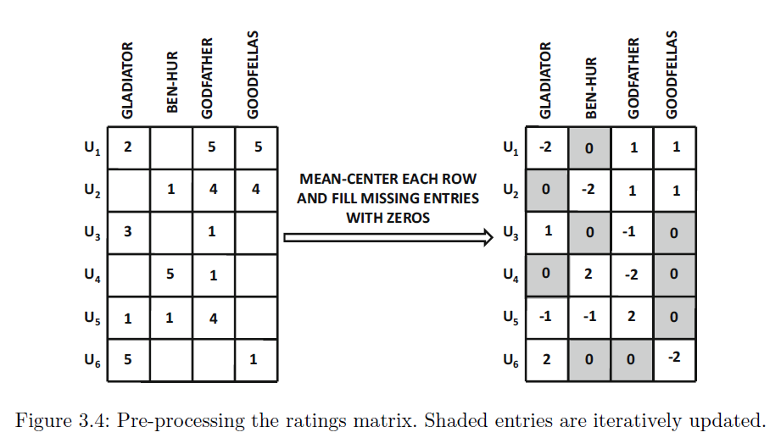

Slide 34
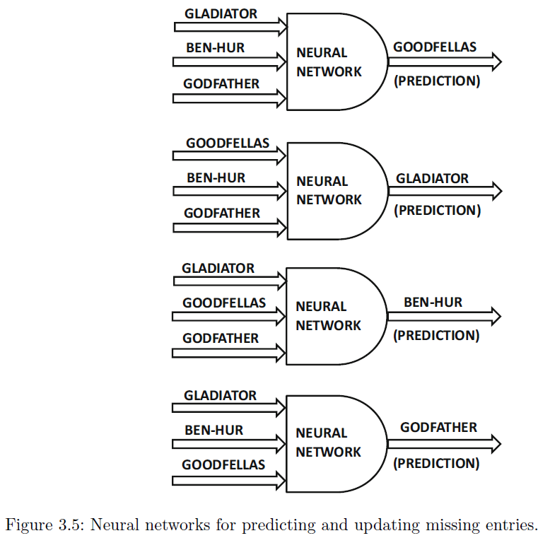

Slide 35
Step 2: Pre-processing the Data
Mean-centering is applied to each row to remove user biases.
Missing entries are initially filled with zero to create a complete dataset.
Example transformation:
User U1 originally rated Gladiator (2) and Goodfellas (5), but after mean-centering, these values are transformed.
Step 3: Neural Network Model
A neural network (Figure 3.3) is used to predict missing values.
A perceptron (Figure 3.3a) is used for basic predictions.
A multilayer neural network (Figure 3.3b) improves predictions by learning patterns in user preferences.

Slide 36
Step 4: Iterative Updates Using a Neural Network
Each movie (Gladiator, Ben-Hur, Godfather, Goodfellas) is treated as a target variable in different iterations.
Other movie ratings serve as input features.
A separate neural network is trained for each movie prediction (Figure 3.5).
Example predictions:
If a user rated Gladiator, Ben-Hur, and Godfather, the neural network predicts their rating for Goodfellas.
The process is repeated for all missing entries.

Slide 37
Step 5: Final Prediction & Recommendation
Iteratively, the shaded missing values in Figure 3.4 are updated.
Predictions converge to final estimated ratings.
Recommended movies are based on the highest predicted scores.
Example Output
Predict Missing Ratings for U3
Given U3's ratings: (Gladiator = 1, Ben-Hur = 0, Godfather = -1, Goodfellas = 0)
We use a Neural Network trained on other users’ data to predict missing ratings.
Predictions:
Gladiator (1) → Correctly retained.
Ben-Hur (0) → Missing initially, replaced with 0.
Godfather (-1) → Correctly retained.
Goodfellas (0) → Missing initially, replaced with 0.
Thus, Gladiator is the best recommendation for U3.

Slide 38
How the Prediction for Godfather (-1) Works?
Identify Similar Users
The model looks at other users who also rated Gladiator = 3 and Ben-Hur = 1.
It finds that most of these users rated Godfather negatively (-1).
This means that users who liked Gladiator and Ben-Hur tended to dislike Godfather.
Compute Probability
The neural network calculates the probability of U3 disliking Godfather.
Since most similar users gave Godfather a -1 rating, the model assigns U3’s missing rating for Godfather as -1.
Make a Prediction
Final Prediction → Godfather = -1 (U3 will likely dislike Godfather).

Slide 39
How the Prediction for Goodfellas (0) Works?
Identify Similar Users
The model again finds users who rated Gladiator = 3 and Ben-Hur = 1.
This time, it finds that some users liked Goodfellas, while others disliked it.
There is no strong positive or negative pattern.
Compute Probability
Since some users gave Goodfellas a positive rating (1) and some gave it a negative rating (-1), the average rating leans toward neutral (0).
The system balances the conflicting opinions and predicts a neutral rating (0) for U3.
Make a Prediction
Final Prediction → Goodfellas = 0 (U3 is expected to feel neutral about Goodfellas).

Slide 40
Latent Factor and Matrix Factorization in Recommender Systems
What is a Latent Factor?
A latent factor is an underlying feature or pattern that influences user preferences but is not directly observable.
These factors help explain the relationships between users and items in a recommender system.
Example of Latent Factors
In a movie recommendation system, latent factors can include:
Genre Preference (e.g., action, drama, comedy)
Actor/Director Influence (e.g., movies starring Tom Hanks)
Movie Era (e.g., classic vs. modern films)
These factors are not explicitly available but can be inferred from user ratings.

Slide 41
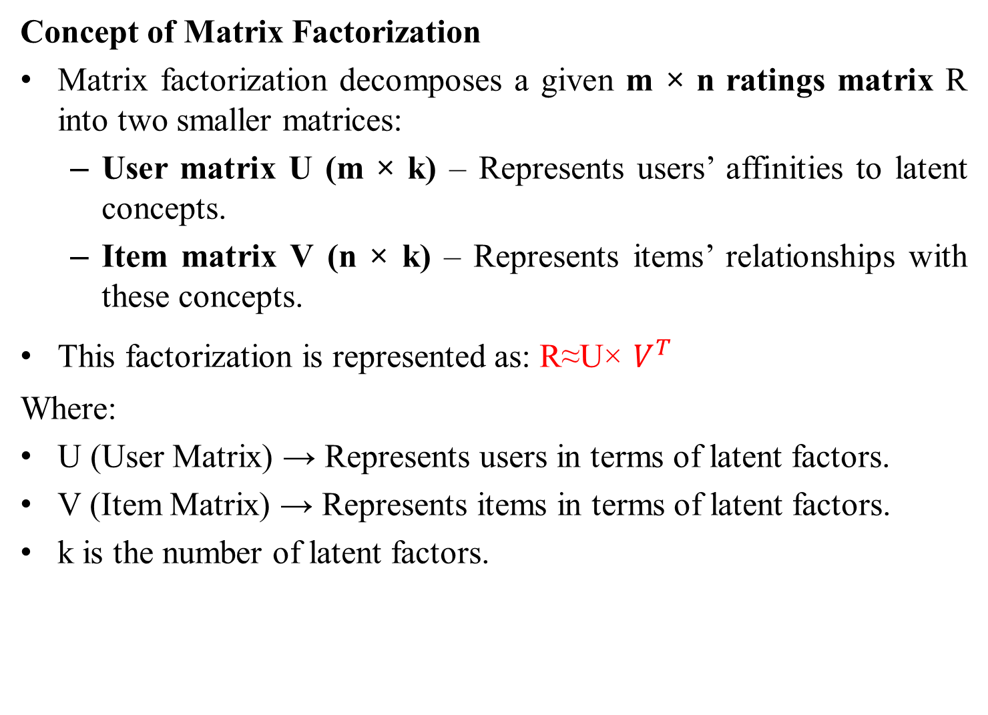
Concept of Matrix Factorization
Matrix factorization decomposes a given m × n ratings matrix R into two smaller matrices:
User matrix U (m × k) – Represents users’ affinities to latent concepts.
Item matrix V (n × k) – Represents items’ relationships with these concepts.
This factorization is represented as: R≈U× $V^{T}$
Where:
U (User Matrix) → Represents users in terms of latent factors.
V (Item Matrix) → Represents items in terms of latent factors.
k is the number of latent factors.

Slide 42

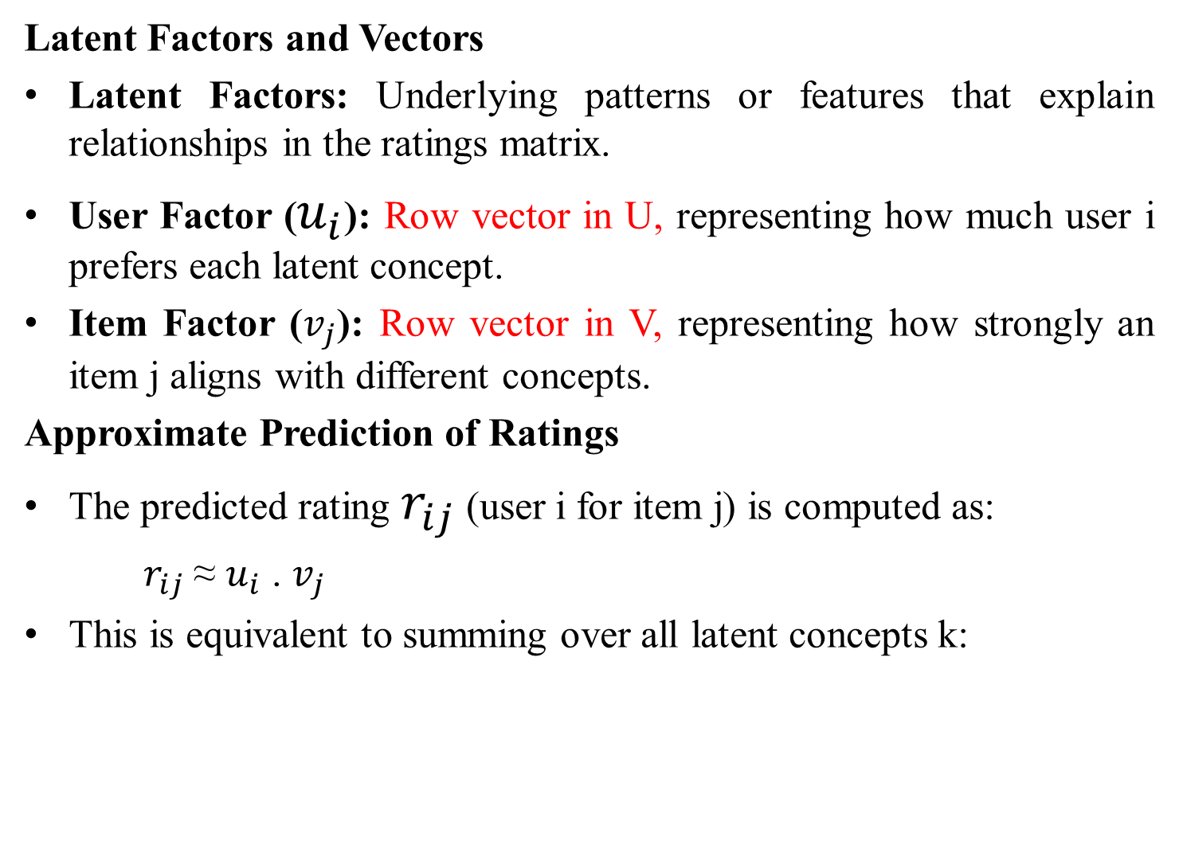
Latent Factors and Vectors
Latent Factors: Underlying patterns or features that explain relationships in the ratings matrix.
User Factor ($u_{i}$): Row vector in U, representing how much user i prefers each latent concept.
Item Factor ($v_{j}$): Row vector in V, representing how strongly an item j aligns with different concepts.
Approximate Prediction of Ratings
The predicted rating $r_{ij}$ (user i for item j) is computed as:
$r_{ij}$ ≈ $u_{i}$ . $v_{j}$
This is equivalent to summing over all latent concepts k:

Slide 43
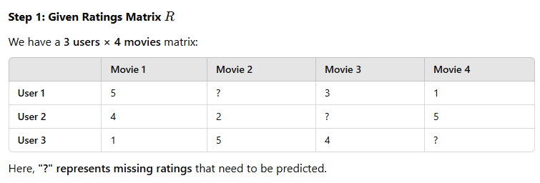
Example of Matrix Factorization in a Recommender System
Let's assume we have a user-movie ratings matrix where users have rated different movies on a scale from 1 to 5.
Some ratings are missing, and we want to predict them using Matrix Factorization.

Slide 44
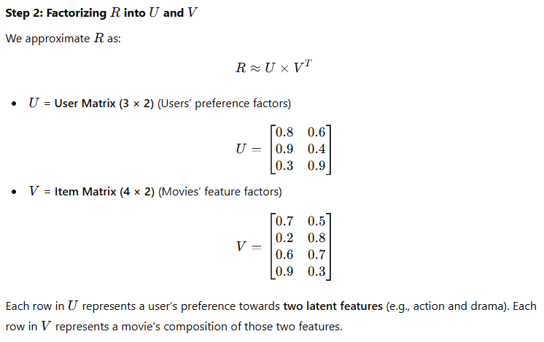
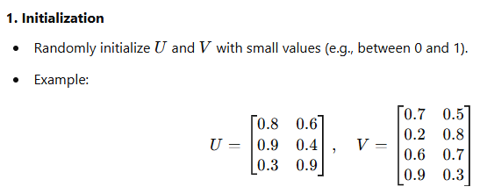

Slide 45
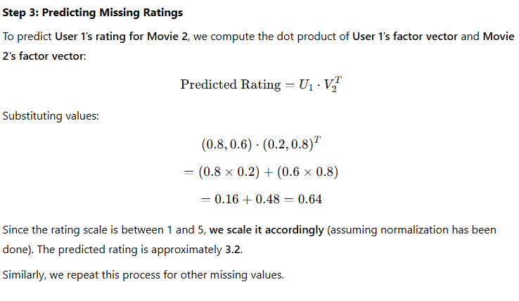

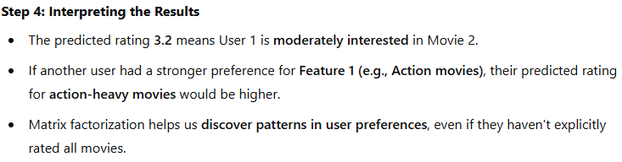

Slide 46
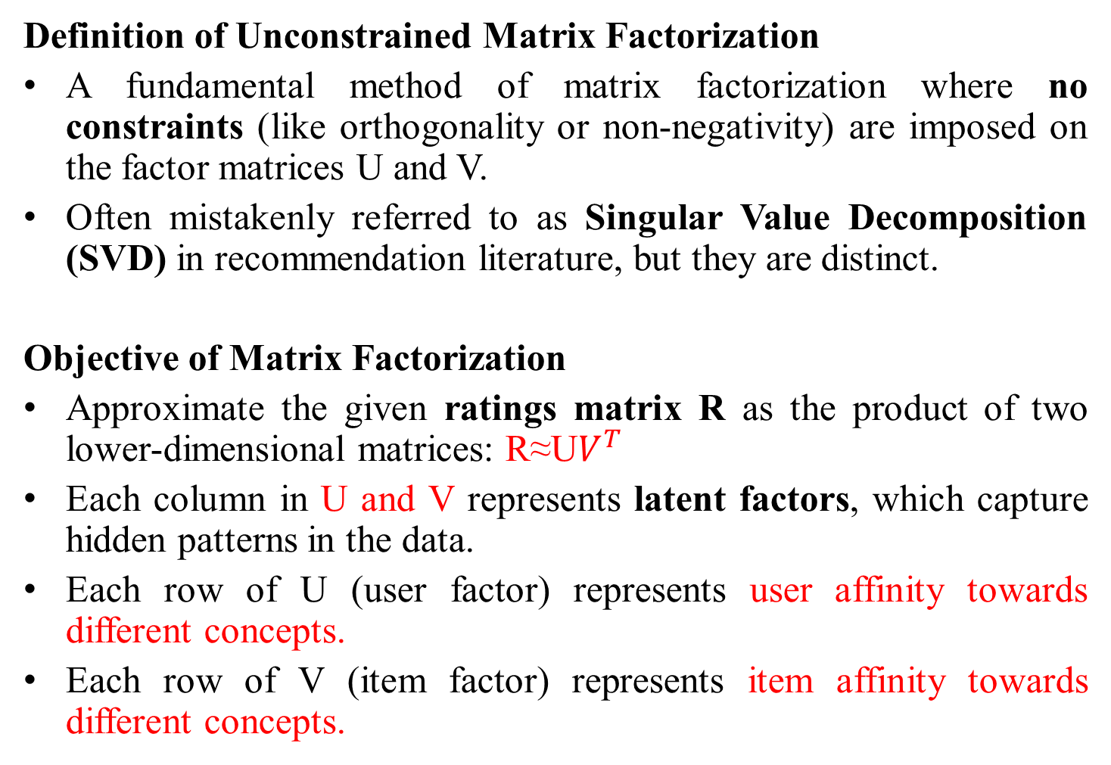
Unconstrained Matrix Factorization
Definition of Unconstrained Matrix Factorization
A fundamental method of matrix factorization where no constraints (like orthogonality or non-negativity) are imposed on the factor matrices U and V.
Often mistakenly referred to as Singular Value Decomposition (SVD) in recommendation literature, but they are distinct.
Objective of Matrix Factorization
Approximate the given ratings matrix R as the product of two lower-dimensional matrices: R≈U$V^{T}$
Each column in U and V represents latent factors, which capture hidden patterns in the data.
Each row of U (user factor) represents user affinity towards different concepts.
Each row of V (item factor) represents item affinity towards different concepts.

Slide 47



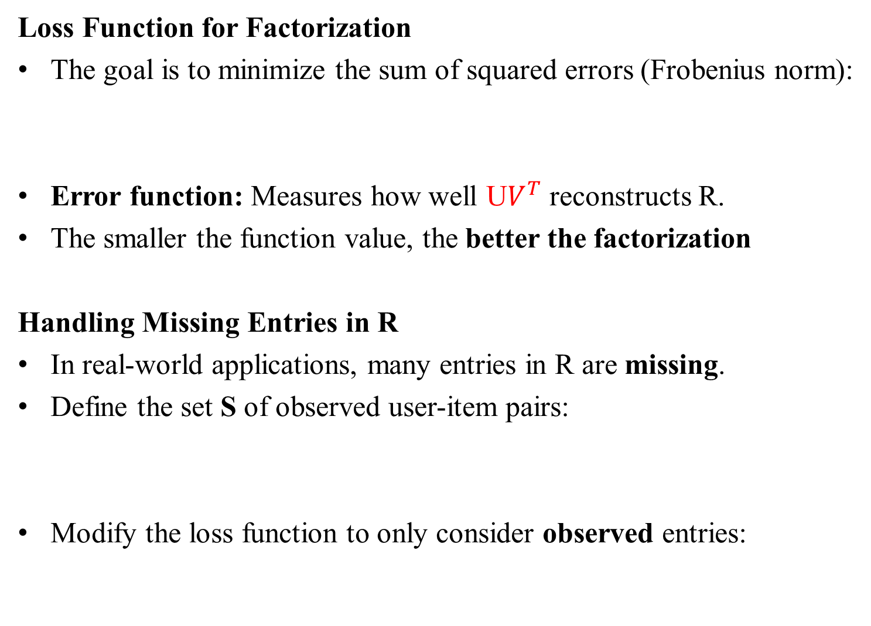
Loss Function for Factorization
The goal is to minimize the sum of squared errors (Frobenius norm):
Error function: Measures how well U$V^{T}$ reconstructs R.
The smaller the function value, the better the factorization
Handling Missing Entries in R
In real-world applications, many entries in R are missing.
Define the set S of observed user-item pairs:
Modify the loss function to only consider observed entries:

Slide 48

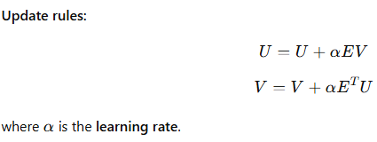
Optimization Using Gradient Descent
Gradient Descent Algorithm is used to update U and V.
Error calculation: Compute residual error between predicted and actual ratings:

Slide 49
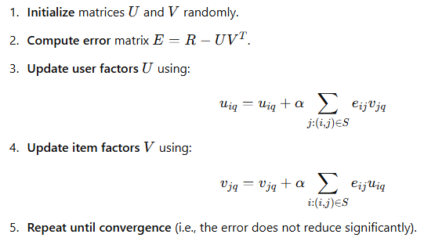
Algorithm for Gradient Descent (Step-by-Step)

Slide 50
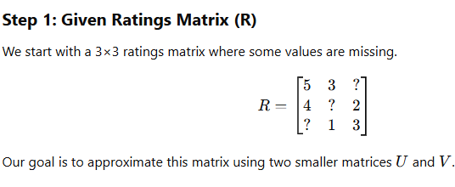
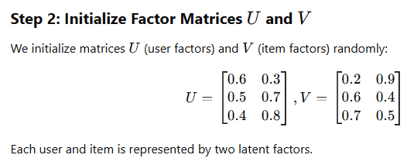
Example: Unconstrained Matrix Factorization with Gradient Descent

Slide 51
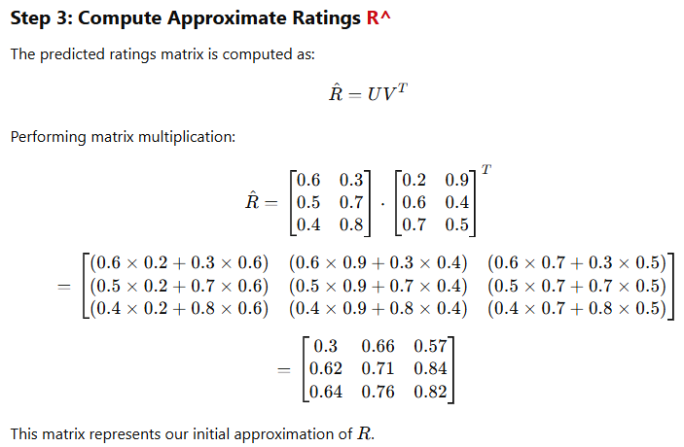

Slide 52
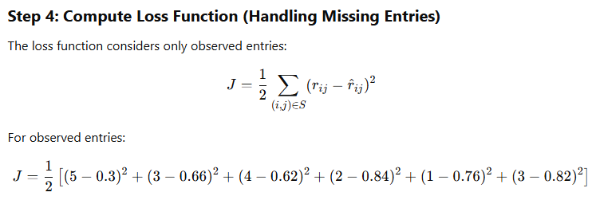
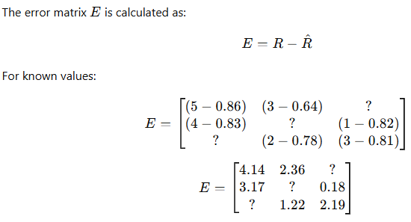
The computed loss function J is 22.5728. This quantifies how far our predictions are from the actual values. ​
Step 5: Compute the Error Matrix

Slide 53
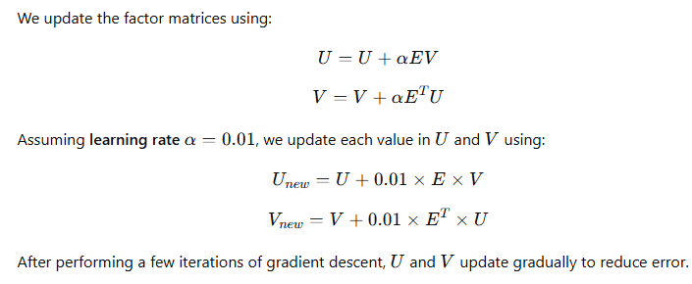


Perform Gradient Descent Update
Predict Missing Values

Slide 54
Stochastic Gradient Descent (SGD) for Matrix Factorization
Introduction to SGD
Stochastic Gradient Descent (SGD) is a method for optimizing matrix factorization.
It updates the matrices U and V one entry at a time instead of considering all entries at once.
Unlike batch gradient descent (which updates using all data at once), SGD processes one observed rating at a time, making it more efficient for large datasets.

Slide 55
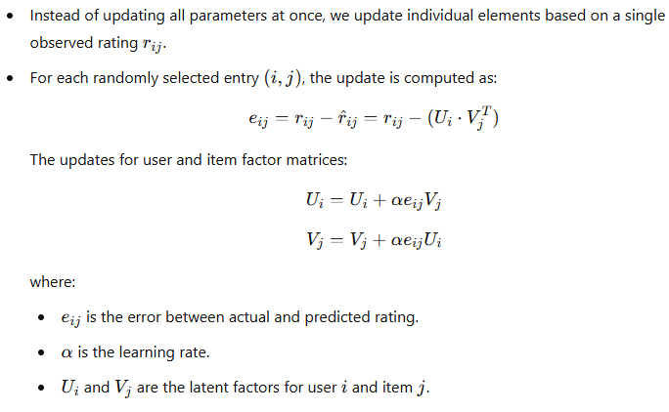
Update Rule in SGD

Slide 56
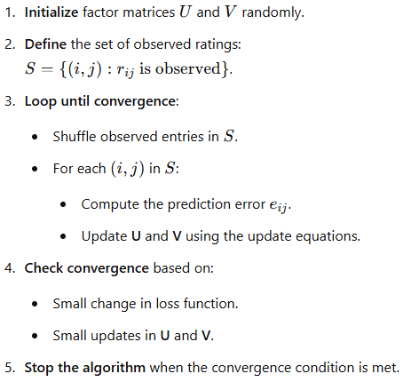
Step-by-Step Algorithm for SGD

Slide 57
Convergence & Learning Rate
SGD is faster than batch gradient descent but has noisier convergence.
Learning rate α is usually small (e.g., 0.005) to prevent large jumps in updates.
Adaptive learning rate methods (e.g., Bold Driver Algorithm) can speed up convergence.
Running too many iterations may overfit the observed data, reducing the generalization on unobserved entries.
Mini-Batch Gradient Descent
Instead of processing one rating at a time (SGD) or all ratings at once (Batch GD), a mini-batch of entries is processed at each step.
This balances computational efficiency and solution quality.

Slide 58
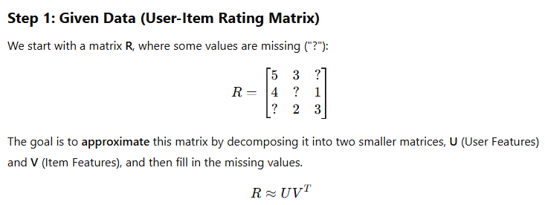
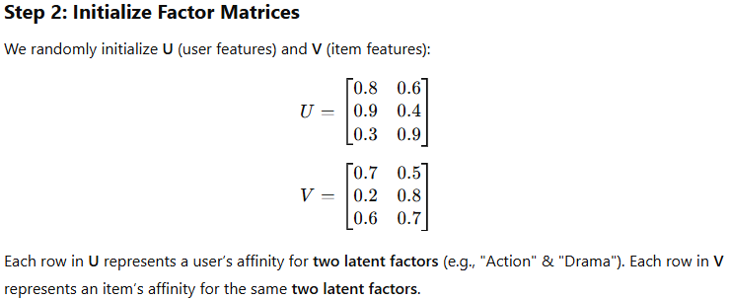
Applying Stochastic Gradient Descent in Matrix Factorization

Slide 59
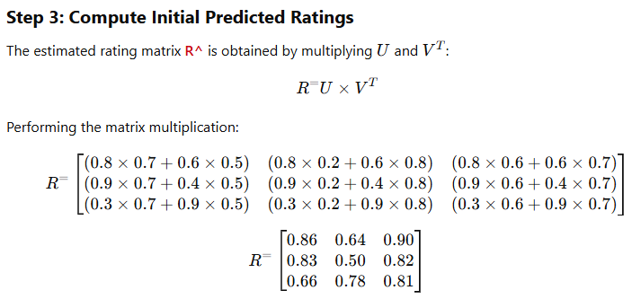
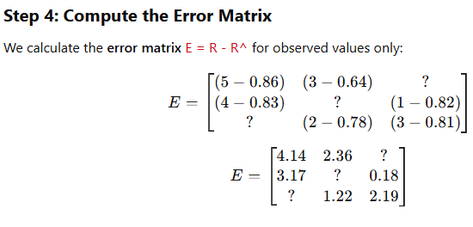

Slide 60
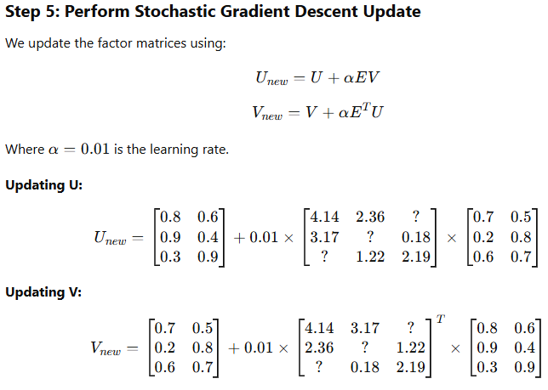

Slide 61



Slide 62
Regularization in Matrix Factorization
Regularization is used to prevent overfitting in sparse rating matrices by discouraging large values in factor matrices U and V.
1. Why Regularization?
In real-world applications, rating matrices are sparse (many missing values).
Direct factorization without constraints may lead to overfitting.
Regularization adds a bias to the model, preferring simpler solutions.

Slide 63

2. Regularized Objective Function
The loss function now includes a penalty term to prevent overfitting:

Slide 64

3. Gradient Descent Updates with Regularization
Regularization modifies the gradient descent updates as follows:

Slide 65


4. Matrix Form Updates
The updates can be written in matrix form:
5. Stochastic Gradient Descent (SGD) with Regularization
Instead of updating all values at once, SGD updates only one observed entry (i , j) at a time:

Slide 66
6. Choosing the Regularization Parameter λ
Hold-out method: Keep some ratings aside, tune λ based on how well predictions match them.
Cross-validation: Split the dataset into multiple parts and test different λ values.
Bayesian Optimization: Automatically tune λ using probabilistic methods.
7. Final Takeaways
Regularization prevents overfitting by discouraging extreme values in U and V.
Gradient descent updates are modified to shrink factor values in every step.
SGD is often preferred for efficiency in large-scale recommendation systems.
Selecting λ\lambdaλ carefully is important for balancing bias and variance.

Slide 67

Applying Regularization in Matrix Factorization Using Gradient Descent
We will go step by step through matrix factorization with regularization, which helps prevent overfitting in sparse rating matrices.

Slide 68



Slide 69



Slide 70



